Slide 1
Blockchain Live
What makes a blockchain for business
V5.0
V5.0, 23 August 2017
Notes:
This is a high level introduction to blockchain concepts and business value. Presentations in this series are:
Blockchain Explained: High level introduction to blockchain for business
Blockchain Solutions: Use-cases, references and how IBM can help
Blockchain Composed: A technical introduction to Hyperledger Composer
Blockchain Architected: A technical introduction to the concepts and components of a blockchain solution
Blockchain Explored: A technical deep dive on Hyperledger Fabric
Blockchain Next Steps: How to proceed on a first project
There is much hype around Blockchain. Most of this relates to the use of Blockchain to underpin the Bitcoin cryptocurrency. Whilst IBM are not interested in cryptocurrency, we are very interested in exploring the broader business application of blockchain technology. This is a transformational opportunity for many of our clients.
IBM is a recognized leader in making blockchain real for business. We are helping many hundreds of clients on their blockchain journeys.
This presentation is the first step! IBM has lots of educational material (signified by the breadcrumb trail at the top of this chart) and a well-defined engagement process that will help. We will take you through all of this later on in this presentation.
The latest copy of this presentation can be found on the IBM intranet at https://ibm.box.com/v/BlockchainExplained. Feel free to distribute a PDF of this file to clients.
This presentation uses the IBM Plex font family, which can be downloaded here: https://ibm.ent.box.com/s/j90l2qhgjfysu6laq1rnt1anxspqxdcb/folder/30078036973

Slide 2

Contents
What is Blockchain?
Why is it relevant for our business?
How can IBM help us apply blockchain?

Slide 3
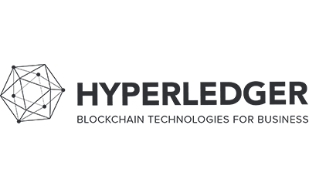
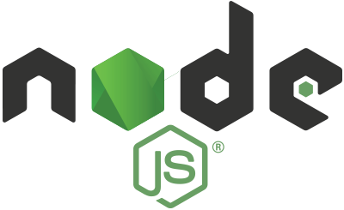
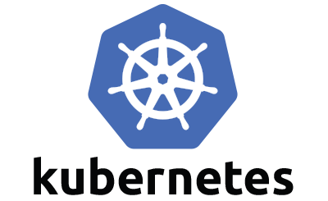
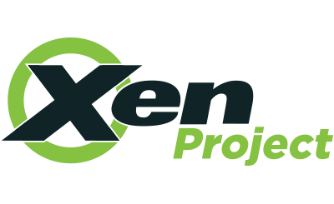
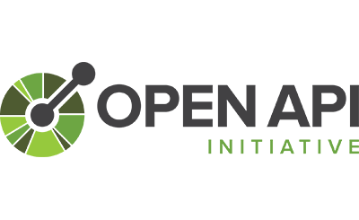

Linux Foundation
One of 67 open projects including…
Hyperledger is an open source collaborative effort created to advance cross-industry blockchain technologies.
Notes:
5 Projects & 3 Tools
Burrow – based on Ethereum Virtual Machine & modular
Fabric – Foundation for developing modular Blockchain applications
Iroha – designed for Infrastructure Projects
Indy – Tools, libraries and componenets for Identities
Sawtooth – Proof of Elapsed time and great for IoT
Cello – Creating, managing and terminating
Explorer – View and monitor (similar to blockchain.info)
Composer – Build business networks, help write smart contracts, deploy

Slide 4
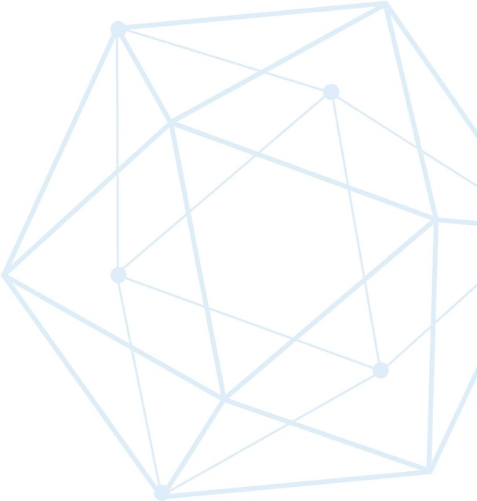
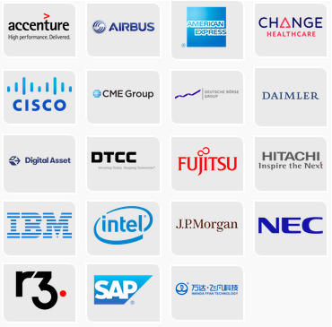
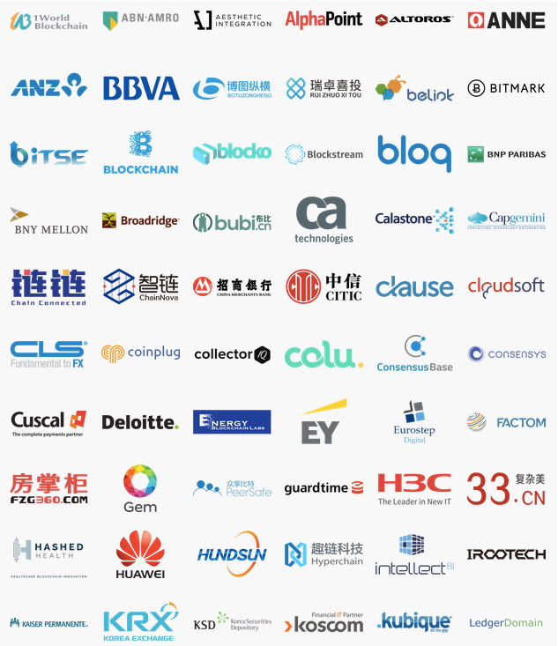
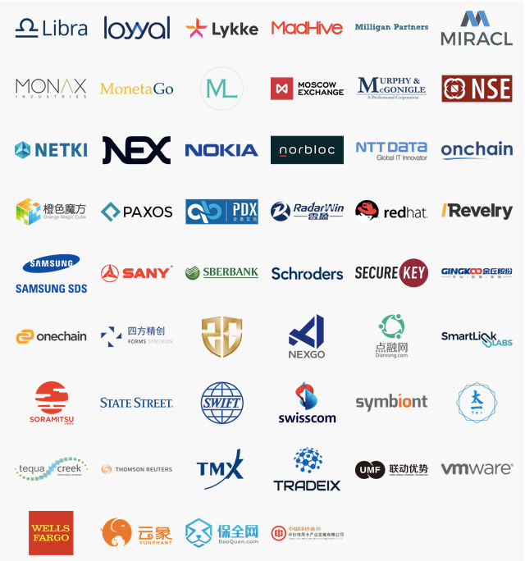

Hyperledger members
Premier
General
Source: https://www.hyperledger.org/about/members
Updated 21 August 2017
Associate
Notes:
Hyperledger is the fastest growing project in Linux Foundation history and has a huge amount of industry support.

Slide 5


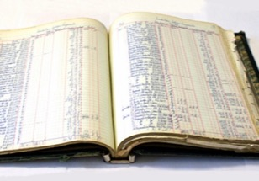





Requirements of blockchain for business
Shared ledger
Smart
contract
Append-only distributed system of record shared across business network
Business terms embedded in transaction database & executed with transactions
Ensuring appropriate visibility; transactions are secure, authenticated & verifiable
Transactions are endorsed by relevant participants
Privacy
Trust

Slide 6
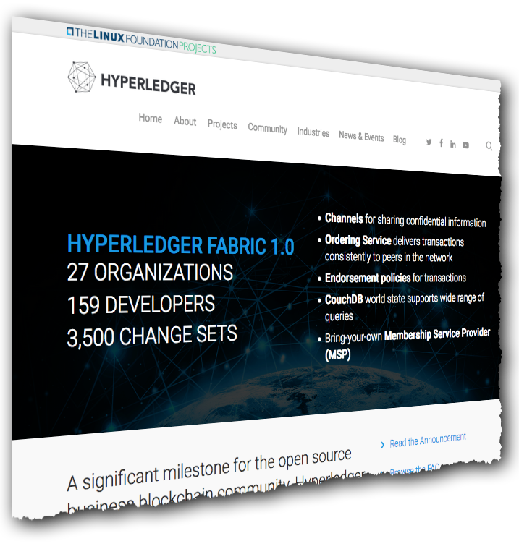
Hyperledger Fabric: Distributed ledger platform
An implementation of blockchain technology that is a foundation for developing blockchain applications
Emphasis on ledger, smart contracts, consensus, confidentiality, resiliency and scalability.
V1.0 released July 2017
159 developers from 27 organizations
IBM is one contributor of code, IP and development effort to Hyperledger Fabric
http://hyperledger-fabric.readthedocs.io/
Notes:
Hyperledger Fabric is one of two Hyperledger projects that IBM is significantly investing in, although it is important to note that Fabric is NOT an IBM project. V1 was released on 11 July 2017 with developers representing 27 different organizations. See https://www.hyperledger.org/blog/2017/07/11/hyperledger-fabric-1-0-is-released.

Slide 7
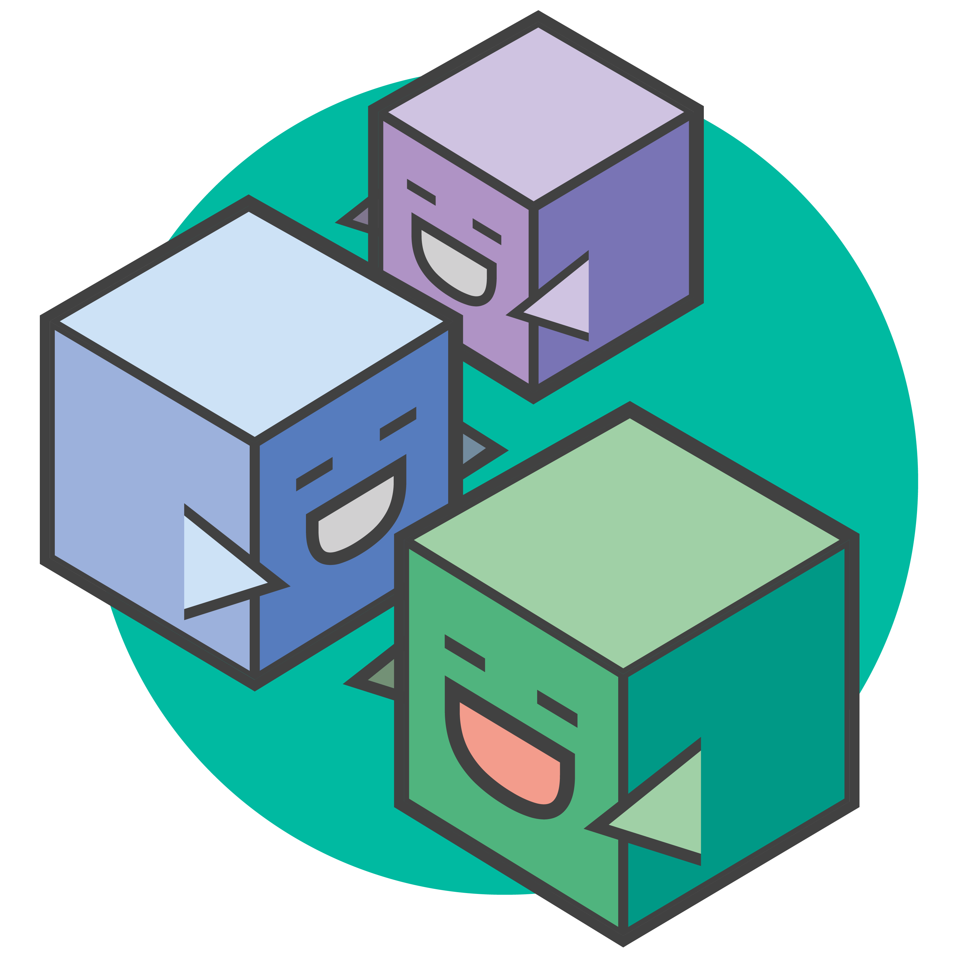
Hyperledger Composer: Accelerating Time to Value
Business Application
https://hyperledger.github.io/composer/
A suite of high level application abstractions for business networks
Emphasis on business-centric vocabulary for quick solution creation
Reduce risk, and increase understanding and flexibility
Hyperledger Composer
Blockchain (Hyperledger Fabric)
Features
Model your business networks, test and expose via APIs
Applications invoke transactions to interact with business network
Integrate existing systems of record
Fully open and part of Linux Foundation Hyperledger
Try it in your web browser now: http://composer-playground.mybluemix.net/
Notes:
Hyperledger Composer aims to bridge the gap between the high level abstractions that have been described in this presentation (i.e. assets, participants and transactions) and the technical realities of Hyperledger Fabric (i.e. invoking code on a distributed processing system).
By exposing a domain specific language and transaction processor functions in Javascript, the effect of Composer is that it allows you to develop blockchain applications very quickly. It saves time and increases flexibility.
Hyperledger Composer is now a Linux Foundation Hyperledger project. It requires Hyperledger Fabric.

Slide 8



What is IBM Blockchain Platform
Develop Explore and accelerate development time with tools that ensure close alignment between business leaders and developers
Govern Speed activation, customization and management of your business network with democratic, multi-party governance tooling
Operate Deploy and operate always-on networks with production-ready enterprise performance and security for most demanding use cases
The only fully integrated enterprise-ready blockchain platform designed to accelerate the development, governance, and operation of a multi-institution business network
Based on Hyperledger Fabric V1 runtime optimized for enterprise requirements
Specialized compute for security, performance and resilience
Full lifecycle tooling to speed activation and management of your network
[http://ibm.biz/Platform_Demo]
© 2017 IBM Corporation
Notes:
Rapidly activate your blockchain network in 1/3 the time:
With tools that help you overcome the difficult collaboration and technical tasks you will run into as you move from ideas to production
Experience of over 400 client engagements at your fingertips with numerous tools to accelerate the heavy lifting required to make your blockchain network a reality
The IBM Blockchain Platform is the only integrated, business ready platform that addresses the full life cycle (develop, govern, and operate) of a multi-organization blockchain network.
Designed to accelerate through phased collaboration the creation of a “built for business” global blockchain network across industries and use cases
In record time, you can:
Collaborate to build your code with team based DevOps leveraging Hyperledger Fabric and Hyperledger Composer
Invite and manage your ecosystem with democratic business rules
Keep the network running in a hyper-secure environment that meets the performance and trust requirements of even the most demanding and regulated industries

Slide 9







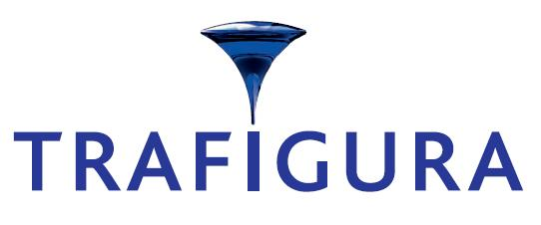




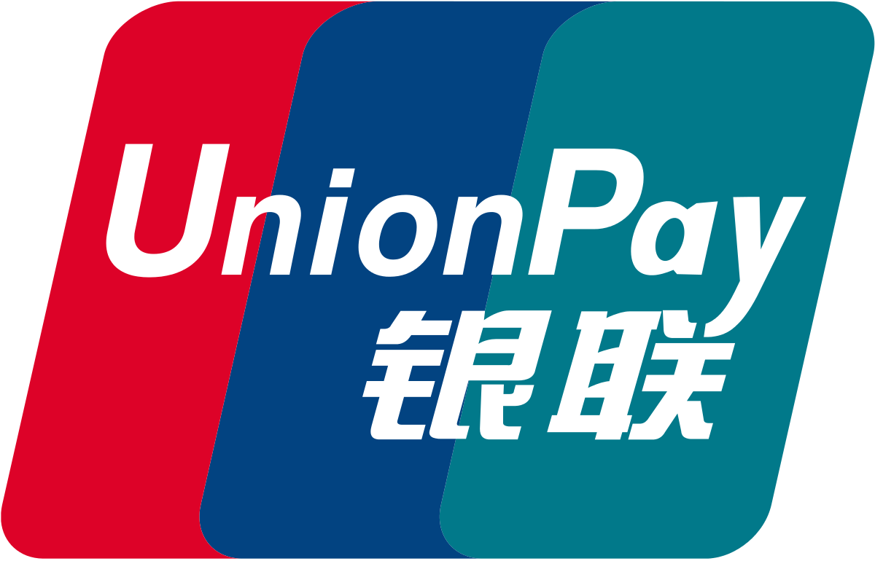




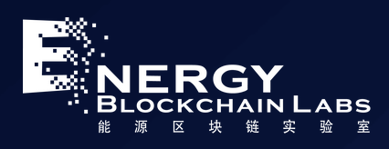





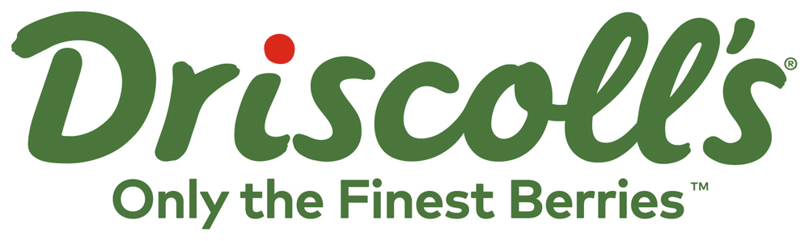



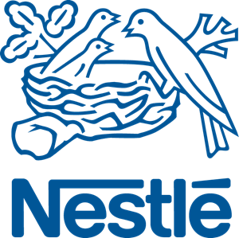



Making blockchain real for business
Trade Finance | Pre and Post Trade | Complex Risk Coverage
Identity/ Know your customer (KYC) | Unlisted Securities/ Private Equity Funds | Loyalty Program
Medicated Health Data Exchange | Fraud/ Compliance Registry | Distributed Energy/ Carbon Credit
Supply Chain | Food Safety | Provenance/ Traceability
Notes:
IBM brings the experience of over 400+ Client engagements and multiple active networks at your ecosystems fingertips.
The IBM Blockchain Platform puts the experience of over 400+ Client engagements and multiple active networks at your ecosystems fingertips.
IBM has a large and increasing number of public references on blockchain.
COMPLETE LIST with references is here > http://ibm.biz/BlockPubRef
Northern Trust:
http://www-03.ibm.com/press/us/en/pressrelease/51655.wss
Maersk:
http://www-03.ibm.com/press/us/en/pressrelease/51712.wss
HSBC, Bank of America, IDA:
http://www.coindesk.com/hsbc-bank-america-blockchain-supply-chain/
ABN AMRO:
https://www.abnamro.com/en/newsroom/blogs/arjan-van-os/2016/walking-the-walk-exploring-the-power-of-blockchain.html
Crédit Mutuel Arkéa:
http://www.coindesk.com/ibm-completes-blockchain-trial-french-bank-credit-mutuel/
JPX:
http://www.ibm.com/press/us/en/pressrelease/49088.wss
Kouvola Innovation:
http://www.ibm.com/press/us/en/pressrelease/49029.wss
London Stock Exchange:
http://www.ibtimes.co.uk/linux-foundation-blockchain-consortium-digital-asset-ibm-credits-london-stock-exchange-board-1533798
Mizuho:
http://www.coindesk.com/mizuho-digital-currency-powered-blockchain-settlement/
IBM Global Finance:
http://www.coindesk.com/ibm-building-blockchain-dispute-resolution-system/
Everledger
https://www-03.ibm.com/press/us/en/pressrelease/50169.wss
Bank of Tokyo Mitsubishi
https://www-03.ibm.com/press/us/en/pressrelease/50544.wss
China UnionPay
http://www.coindesk.com/ibm-china-unionpay-blockchain-loyalty-exchange/
CLS
http://www.coindesk.com/cls-to-develop-blockchain-payment-service-on-ibm-fabric/
UBS
http://www.coindesk.com/ubs-blockchain-prototype-trade/
IBM GF: http://www.coindesk.com/ibm-building-blockchain-dispute-resolution-system/

Slide 10
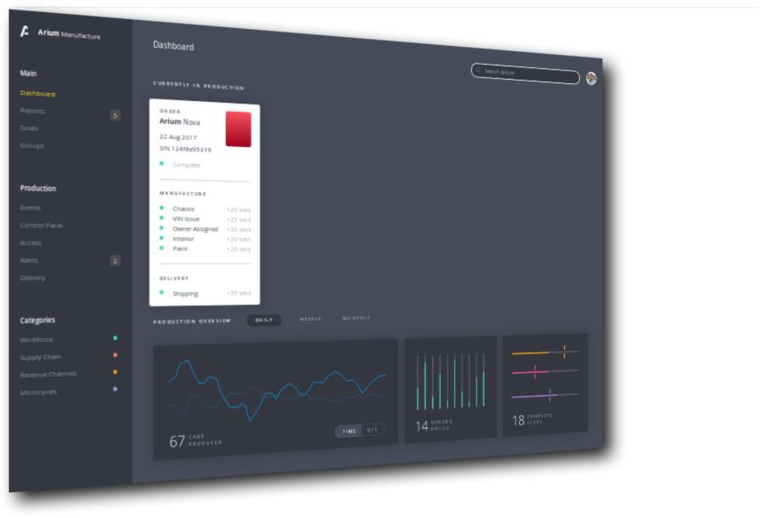
Vehicle Lifecycle Demo

Slide 11
Benefits of Hyperledger Composer
Increases understanding | Saves time | Reduces risk | Increases flexibility
Bridges simply from business concepts to blockchain | Develop blockchain applications more quickly and cheaply | Well tested, efficient design conforms to best practice | Higher level abstraction makes it easier to iterate
Notes:
Purpose: Why using Fabric Composer is great!
Say:
INCREASE UNDERSTANDING: With the language used by fabric composer is much more business friendly talking in Assets, Participants & Transactions enabling the gap between developers and business knowledge
SAVE TIME: Fabric composer has been built from the ground up with agile in min such as easy to test what was just written and using tools to turn what was created into live API’s and usable front end for end user testing in minutes
REDUCES RISK: with the increased ease of testing and ability for multiple personas to read and understand what has been written (amalgamation of previous 2 benefits) this provides much more stability and much more likely the end system will provide the business benefits required.
INCREASED FLEXIBILITY: As composer has been designed from agile developing, the ability to update the code and links to github to manage versioning then test this within minutes makes iterating imporvements easy.
References: Next slide shows how some of these benefits are realized with the tool choices

Slide 12
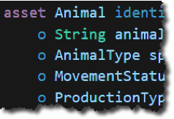
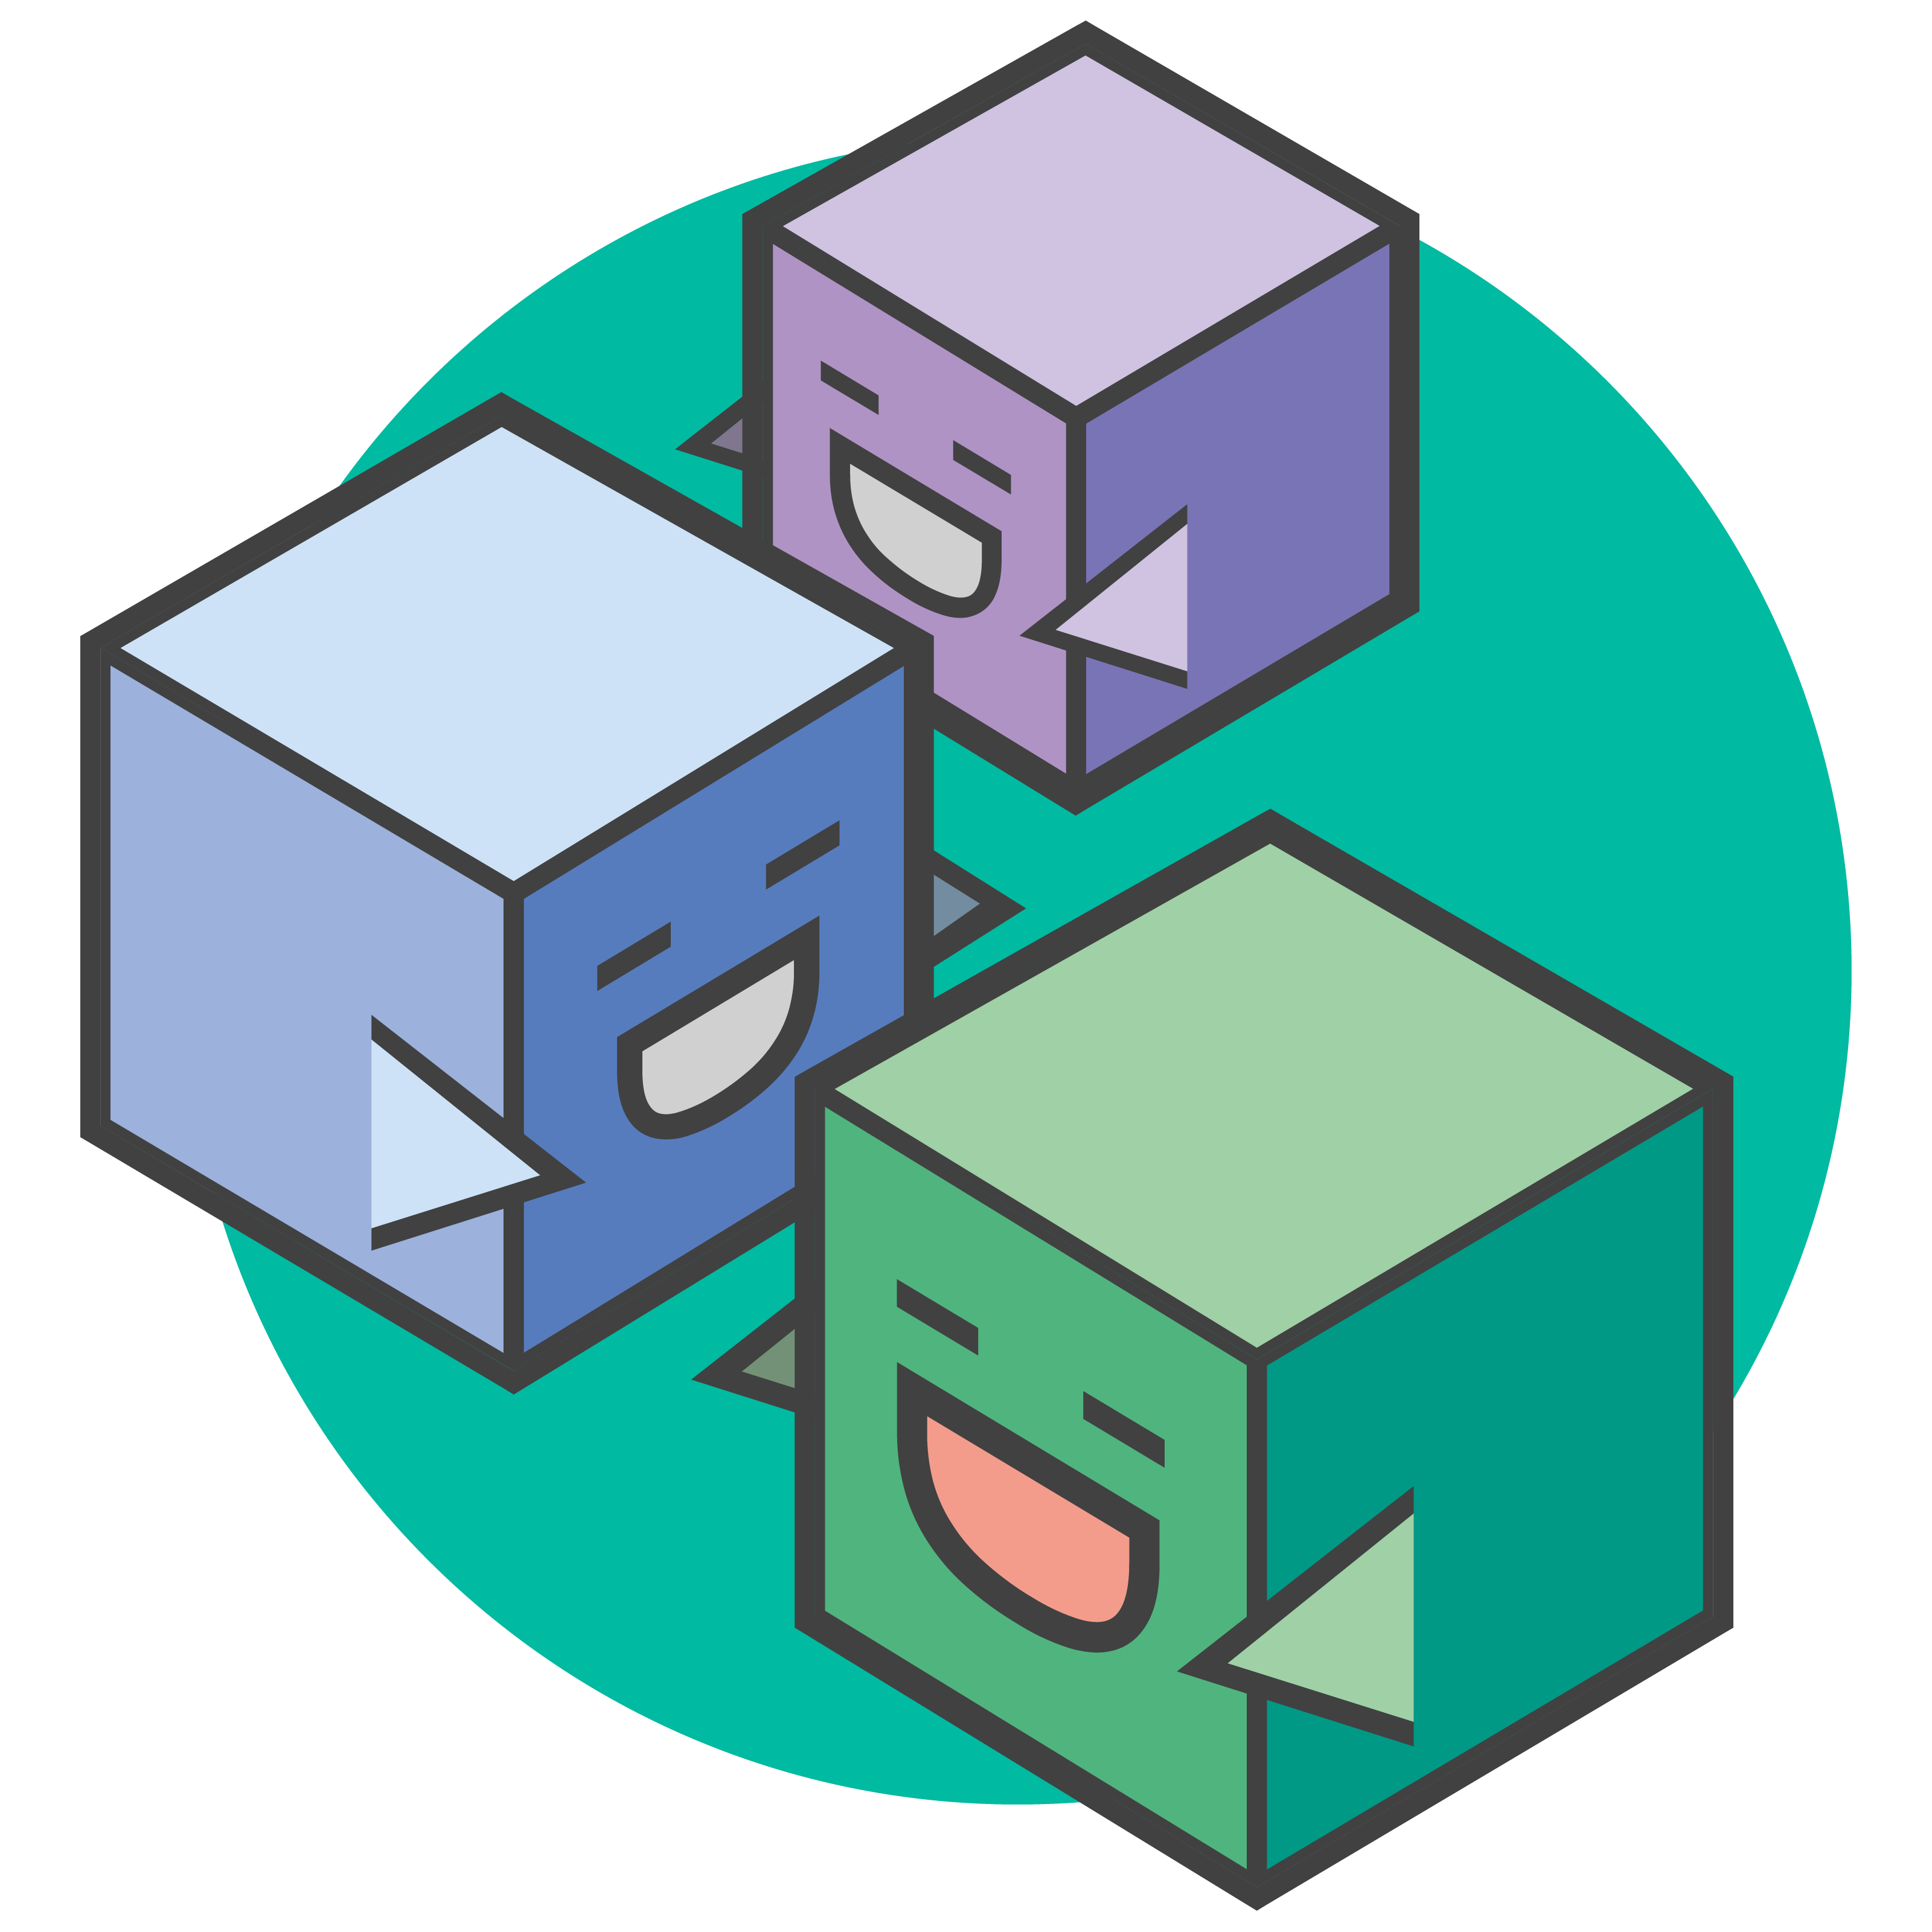
Open Source & Familiar Tools
Data modelling
JavaScript business logic
Web playground
Client libraries
composer-client
composer-admin
Editor support
CLI utilities
Code generation
Existing systems and data
$ composer
Swagger
Notes:
Purpose: Show the tools being worked with are familiar to many dev
Say: Most of these tools are commonly taught at uni so there is a large skill base to make use of when making blockchain
DATA MODELING: language is new language being looked at in more detail in a few slides but closely matches the realities of business. More on this later.
JAVA SCRIPT: one of the top 10 most popular languages and all decent computer science graduate will have some knowledge on how to program in this, also popular with more experienced developers
WEB PLAYGROUND: The playground is a web page that simulates having a blockchain and dev environement for you without needing to install anything. Load the page and get going. This is designed for developers or business analysts who want to get going quick to understand if this is something they can use, then later install the local version to use editors and connect to real blockchains. More on this later in pack. NPM is becoming very popular and an easy modular framework for developers to build upon. Various options available depending on your persona and what you need the tool to do
EDITOR: The framework will work allow any editor to be used, so far Atom & VisualStudio Code are supported, more will come as the open community adds their connectors – see anecdotes
CLI: a popular method of connecting to, managing and opperating systems o this is available complete with full help guides as standard in other CLI utilities
YO: Yoeman is a scaffolding tool for modern web apps. It can writing your build configuration (e.g Gulpfile) and pulling in relevant build tasks and package manage
EXISTING SYSTEMS: Loopback & Swagger (round green logo) are also open source projects. Loopback creates a full set of APIs for you based upon what have been made in Fabric Composer. Swagger is the most popular framework for APIs which visually renders your Swagger definition with concise, real time feedback and error handling
References & Anecdotes: Atom was planned to be our only initial editor supported, VS Code was added by one of our team familiar with VS code but not part of Composer dev team. Within a short amount of time he had

Slide 13

User Roles in a Blockchain Project
Application Developer
Developing the application that interacts with the ledger
Modelling the business network
Implementing the script files that define transaction behaviour
Solution Administrator
Provisioning the target environment
Deploying the business application
Managing the blockchain
Business Network Participant
Running an end-user application that invokes transactions
Aware of business concepts: assets, participants and transactions
May not be aware of blockchain underpinnings
D
A
P

Slide 14

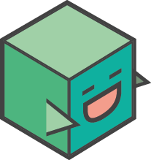

Developer Concepts
Applications
Models
Scripts
Provides front-end for the user
May require different applications per participant
Interacts with the registries
Add, delete, update, query
Registries persisted on blockchain
Connects to blockchain via JavaScript client libraries (SDK) or REST
A domain specific language (.CTO) that defines the type structure of
Assets
Participants
Transactions
Aims to match how we talk about business networks in the real world
Scripts provide the implementation of transaction processor logic
Specified in Javascript
Designed for any reasonable Javascript developer to pick up easily

Slide 15
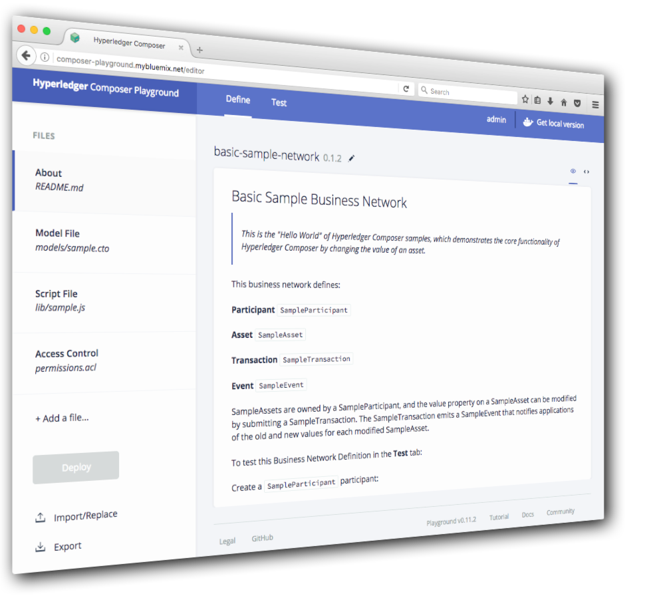
Demo: Composer Playground & Integration

Slide 16
We’ve partnered with startup and technology incubators to establish exciting spaces worldwide.
Tokyo
Hakozaki
San Francisco partnered with Galvanize
Or we bring a pop-up garage to you
Toronto partnered with the Digital Media Zone (DMZ)
Singapore
MBFC
New York
partnered with Galvanize
London
partnered with WeWork Moorgate
Nice
partnered with CEEINCA
Melbourne
partnered with Carlton Connect Initiative

Slide 17




Composer Community
hyperledger.github.io/composer
Weekly
Community
Calls
Hyperledger Meetup’s
#Hyperledger #Composer

Slide 18




Getting started on your blockchain journey
Learn More About IBM Blockchain | Schedule an IBM Blockchain Workshop
Develop a Blockchain Application | Activate and Grow your Blockchain Network
Notes:
As of end-2016, IBM has over 400 clients going through this pipeline (public information).
Blockchain Hands-on is analogous to a proof-of-technology, but is designed for business people in addition to technical people.
First project is analogous to a proof-of-concept, but is designed to provide real and ongoing value to the client rather than being disposable.
We do not recommend short-cutting any stage in this process.

Slide 19
Thank you
www.ibm.com/blockchain
developer.ibm.com/blockchain
www.hyperledger.org
© Copyright IBM Corporation 2017. All rights reserved. The information contained in these materials is provided for informational purposes only, and is provided AS IS without warranty of any kind, express or implied. Any statement of direction represents IBM's current intent, is subject to change or withdrawal, and represents only goals and objectives. IBM, the IBM logo, and other IBM products and services are trademarks of the International Business Machines Corporation, in the United States, other countries or both. Other company, product, or service names may be trademarks or service marks of others.

